Slide 1



SpaceX Falcon 9
First-Stage Landing Prediction
IBM Applied Data Science Capstone
Final Project Presentation
Travis Reinart
October 18, 2026
github.com/treinart/IBM-Data-Science-Professional-Certificate

Slide 2

Outline
CLICK AN ENTRY TO JUMP TO ITS PAGE
Executive Summary
Page 3
Introduction
Page 4
Section 1 Methodology
Page 5
Section 2 Insights drawn from EDA
Page 21
Section 3 Launch Sites Proximities Analysis
Page 38
Section 4 Build a Dashboard with Plotly Dash
Page 42
Section 5 Predictive Analysis
Page 46
Conclusion
Page 49
Appendix
Page 50
2

Slide 3
Executive Summary
Key Finding: Landing success improved on later flights. The final model identified every success, but only half of failures.
METHODOLOGY USED
SUMMARY OF RESULTS
01
API collection, web scraping, outcome labeling
90-launch model set: 60 successful landings, 30 unsuccessful outcomes.
02
Visual EDA by flight, payload, orbit, site and year
Later flights improved. 2019: 9/10; 2020: 16/19. VLEO: 12/14; GTO: 14/27.
03
SQL queries on sites, payloads, missions and landings
Four sites; NASA (CRS) payload totaled 45,596 kg; first ground-pad success: Dec 22, 2015.
04
Folium mapping of outcomes and nearby features
Four sites mapped in California and Florida; launch clusters and proximity distances measured.
05
Dash site and payload filters with pie and scatter views
Dashboard sample: 24 successes across sites; 2,000–6,000 kg range: 18/34 successes.
PREDICTIVE MODELING
SELECTED SVM
FINAL CLASS RESULTS
4 tuned classifiers
83.3%
Success (12): precision .80 | recall 1.00 | F1 .89
One-hot encoding, scaling, 72/18 split and 10-fold grid search.
15/18 test • LR + KNN tied
84.8% cross-validation
Failure (6): precision 1.00 | recall .50 | F1 .67
3 false positives • 0 false negatives
3

Slide 4
Introduction
Why do some Falcon 9 first stages land while others do not?
WHAT I WANTED TO FIND OUT
THE WORK BEHIND THIS DECK
I worked through the launch records to see whether flight history, payload, orbit, and launch site had anything to do with the landing result.
I checked the records with charts and SQL, mapped the launch sites, built a dashboard, and tested four prediction models.
This presentation shows what I found and where the models still missed.
01
02
Did successful landings become more common as Falcon 9 flew more missions?
Did outcomes differ by payload, orbit, booster, or launch site?
03
04
What did the SQL results and maps reveal that the charts alone could not?
How well could the models identify both successful and unsuccessful landings?
4

Slide 5

Section 1

Slide 6




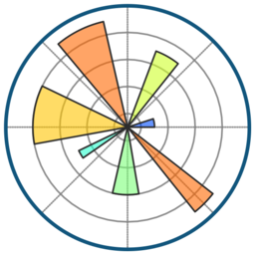






Methodology Executive Summary
Structured 5-stage data science pipeline from raw flight records to tested landing models
STAGE / PHASE
METHODOLOGY & KEY ACTIVITIES
TOOLS & LIBRARIES
COLLECT
Fetched SpaceX launch records via REST API and scraped archived Falcon 9 launch tables from Wikipedia.
01
Requests
Beautiful Soup
WRANGLE
Filtered Falcon 9 flights, imputed missing payload mass by mean, and encoded binary landing outcomes (0/1).
02
Pandas
NumPy
EDA + SQL
Analyzed flight correlations by launch site, orbit, and payload mass using statistical queries and visual plots.
03
Matplotlib
Seaborn
SQLite
MAP + DASH
Built interactive maps of launch sites, landing outcomes, and coastal distances alongside real-time payload filters.
04
Folium
Plotly
Dash
PREDICT
Standardized features, tuned 4 classifiers (Logistic Regression, SVM, Decision Tree, KNN) via 10-fold CV, and evaluated test accuracy.
05
scikit-learn
6

Slide 7

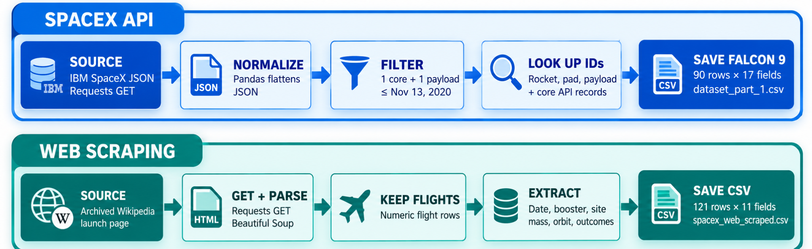

How the Launch Datasets Were Collected
Structured dual-pipeline strategy combining official REST API retrieval and HTML table scraping
SPACEX API PIPELINE
Notebook: jupyter-labs-spacex-data-collection-api-v2.ipynb
Output File: dataset_part_1.csv (90 rows × 17 fields)
WEB SCRAPING PIPELINE
Notebook: jupyter-labs-webscraping.ipynb
Output File: spacex_web_scraped.csv (121 rows × 11 fields)

Slide 8

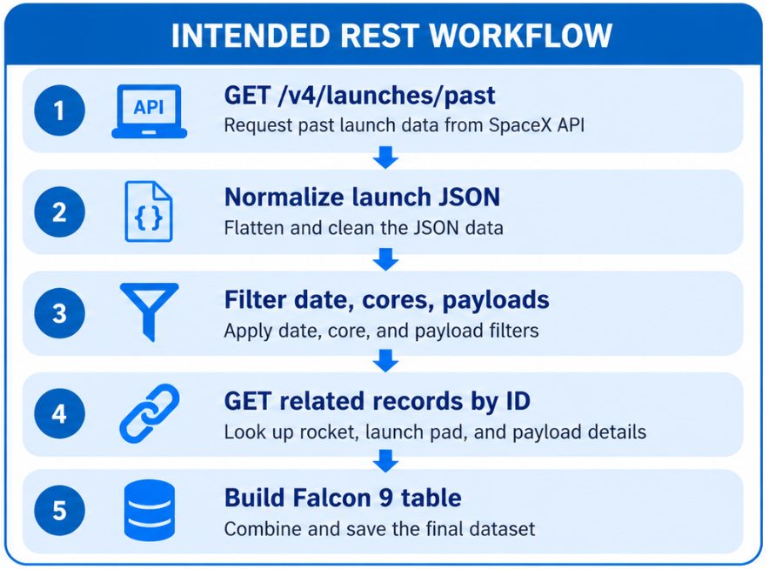
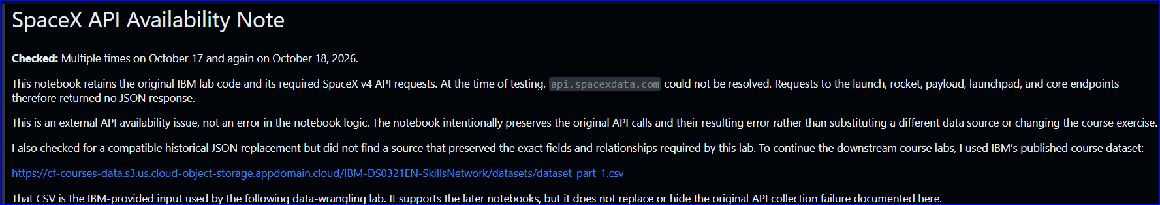
Data Collection – SpaceX API
KEY PHRASES
PRIMARY CALL
GET /v4/launches/past
RECORD PREP
Normalize JSON; one core and one payload
LINKED LOOKUPS
Rocket, launchpad, payload, and core IDs
TARGET OUTPUT
Falcon 9 launch table → dataset_part_1.csv
https://github.com/treinart/IBM-Data-Science-Professional-Certificate/blob/main/10_Applied%20Data%20Science%20Capstone/Module%201/jupyter-labs-spacex-data-collection-api-v2.ipynb

Slide 9
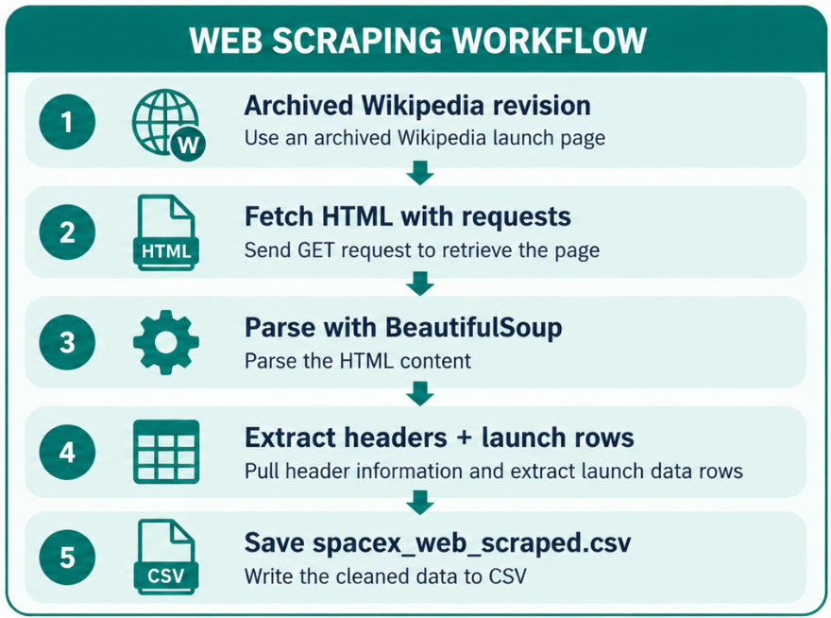
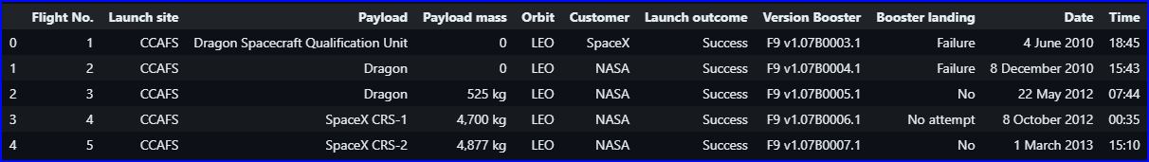
Data Collection – Web Scraping
KEY PHRASES
SOURCE PAGE
Archived Falcon 9 and Falcon Heavy launches
REQUEST + PARSE
requests.get() and BeautifulSoup
TABLE EXTRACTION
Read launch table headers and rows
SAVED RESULT
121 records · 11 fields · CSV export
https://github.com/treinart/IBM-Data-Science-Professional-Certificate/blob/main/10_Applied%20Data%20Science%20Capstone/Module%201/jupyter-labs-webscraping.ipynb
NOTEBOOK OUTPUT · FIRST FIVE SCRAPED LAUNCHES

Slide 10
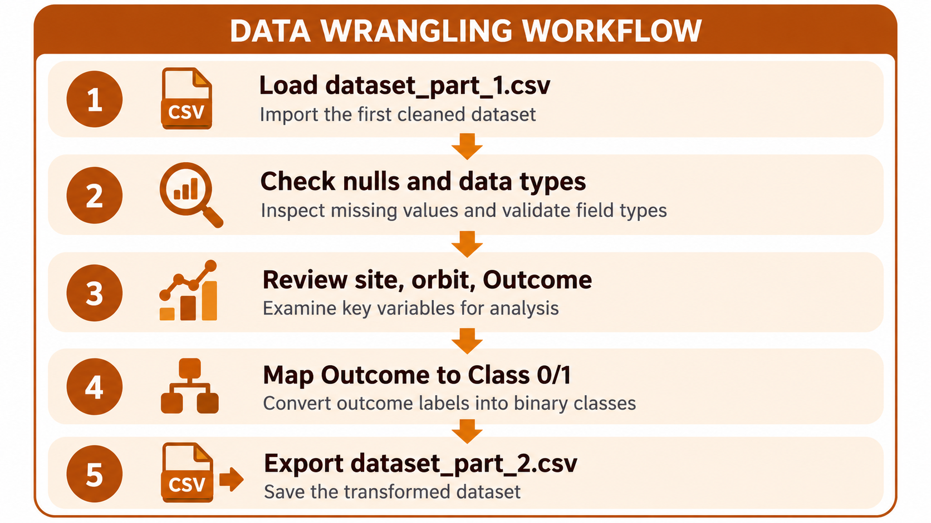
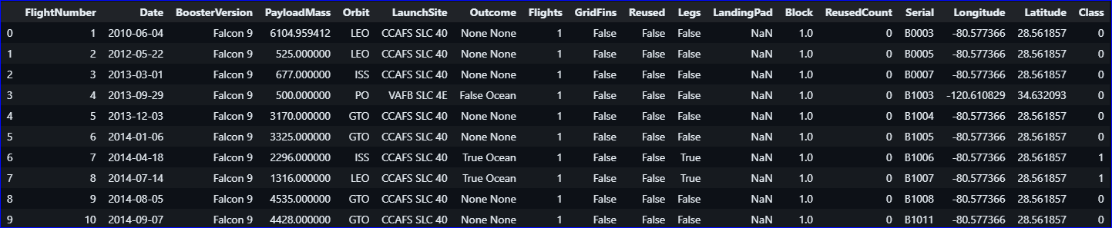
Data Wrangling
KEY PHRASES
INPUT
dataset_part_1.csv · 90 Falcon 9 launches
DATA CHECKS
Missing values, data types, site and orbit counts
LANDING TARGET
Outcome → Class: 1 success, 0 otherwise
OUTPUT
dataset_part_2.csv · 90 rows, 18 fields
https://github.com/treinart/IBM-Data-Science-Professional-Certificate/blob/main/10_Applied%20Data%20Science%20Capstone/Module%201/labs-jupyter-spacex-Data%20wrangling-v2.ipynb
NOTEBOOK OUTPUT · FIRST TEN WRANGLED LAUNCHES

Slide 11
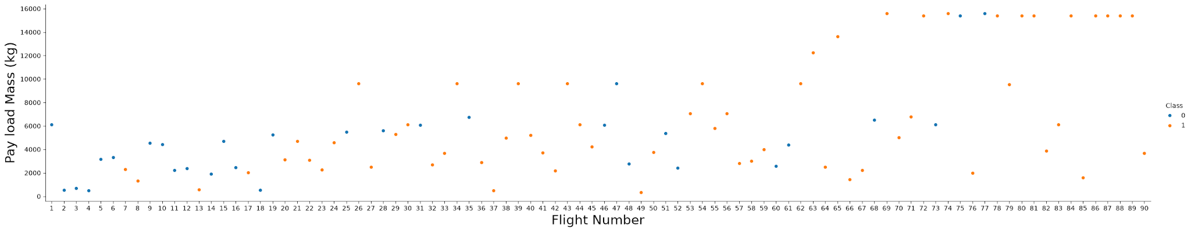
EDA with Data Visualization
CHART TITLE
CHART TYPE
REASON FOR USING IT
Flight Number vs. Payload Mass
Scatter plot
Keeps each launch visible across flight order and payload weight; grouping the data would hide individual landing outcomes.
Flight Number by Launch Site
Scatter plot
Separates each site’s flight history so the overall trend does not stand in for every site.
Payload Mass by Launch Site
Scatter plot
Shows the payload range at each site; an average would conceal which weights were never flown there.
Average Landing Success Rate by Orbit
Bar chart
Orbit types are separate categories, so bars put their success rates on a common scale.
Flight Number by Orbit Type
Scatter plot
Shows whether the pattern across later flights holds within each orbit type.
Payload Mass by Orbit Type
Scatter plot
Keeps the payload ranges of different orbit types separate when reading landing outcomes.
Average Landing Success Rate by Year
Line chart
Years have an order; the line shows changes and reversals in the annual rate.
SAMPLE OUTPUT · FLIGHT NUMBER VS. PAYLOAD MASS
11
https://github.com/treinart/IBM-Data-Science-Professional-Certificate/blob/main/10_Applied%20Data%20Science%20Capstone/Module%202/jupyter-labs-eda-dataviz-v2.ipynb

Slide 12
EDA with SQL
QUERIES 1–5
QUERIES 6–10
01
List distinct launch sites with SELECT DISTINCT.
06
List boosters that landed on a drone ship with payloads above 4,000 and below 6,000 kg.
02
Return five launch records from sites beginning CCA with LIKE and LIMIT.
07
Count each mission outcome with GROUP BY and COUNT.
03
Total NASA (CRS) payload mass with SUM.
08
Find every booster tied for the maximum payload mass with MAX.
04
Calculate average F9 v1.1 payload mass with AVG.
09
Extract the month, booster and launch site for 2015 drone-ship landing failures.
05
Find the first successful ground-pad landing date with MIN.
10
Count and rank landing outcomes from June 4, 2010 through March 20, 2017 with RANK().
https://github.com/treinart/IBM-Data-Science-Professional-Certificate/blob/main/10_Applied%20Data%20Science%20Capstone/Module%202/jupyter-labs-eda-sql-coursera_sqllite.ipynb

Slide 13
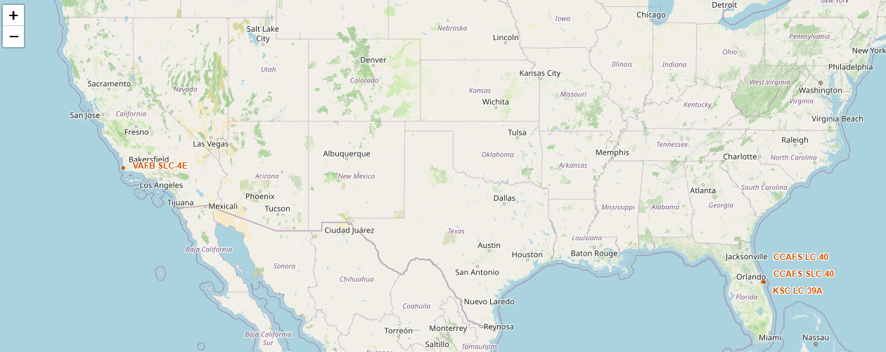
Build an Interactive Map with Folium
FOLIUM FEATURE
COMPONENT TYPE
IMPLEMENTATION & REASON
Circles and popups
CircleMarker
Mark four pads with 1 km circles and show each site name on click.
Offset DivIcon labels
DivIcon
Keep pad names visible where Florida sites sit close.
MarkerCluster
FastMarkerCluster
Group launches that share pad coordinates so markers remain accessible.
Launch markers and popups
Outcome Marker
Show each landing outcome with a green/red icon and identify the launch on click.
MousePosition
Coordinate Plugin
Read coordinates for selected coastline, railway, highway and city points.
Distance labels and PolyLine
PolyLine & Text
Display calculated kilometres and connect each measured point to its launch pad.
https://github.com/treinart/IBM-Data-Science-Professional-Certificate/blob/main/10_Applied%20Data%20Science%20Capstone/Module%203/lab-jupyter-launch-site-location-v2.ipynb

Slide 14
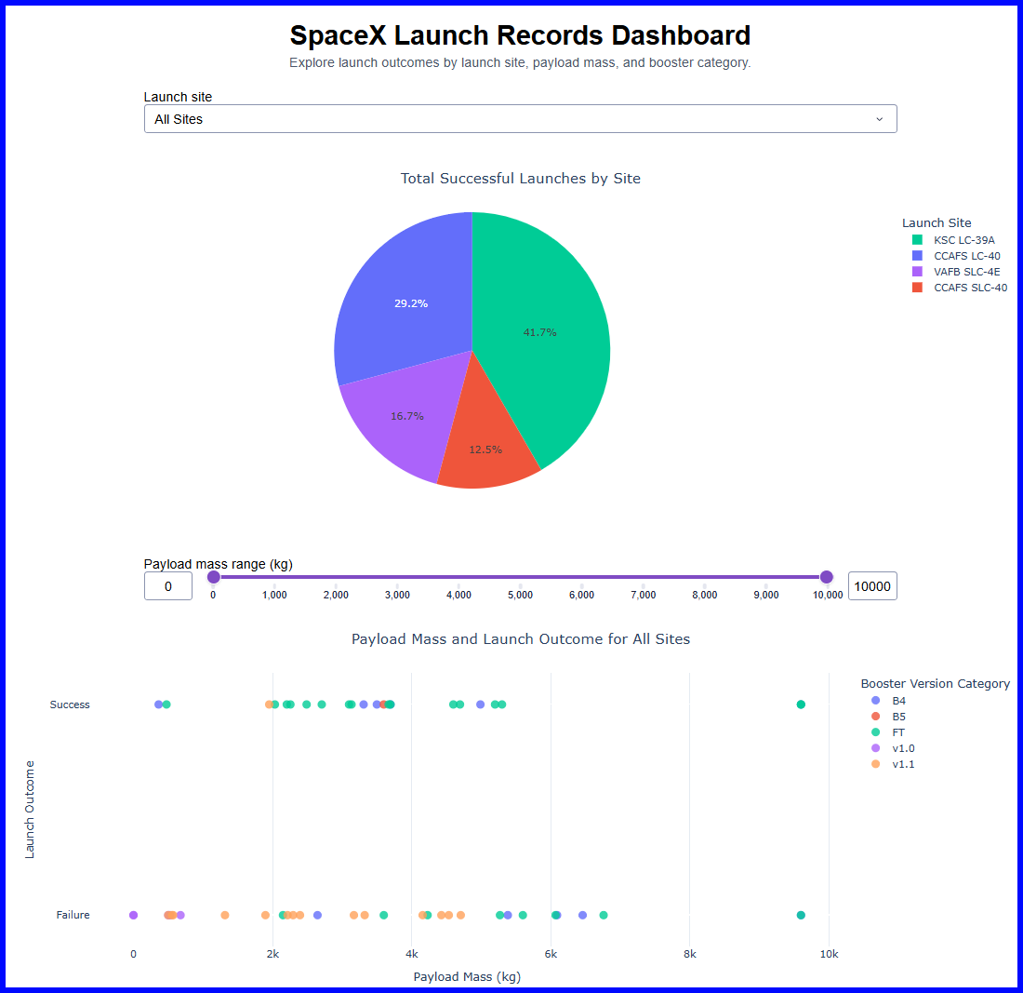
Build a Dashboard with Plotly Dash
Live dashboard: https://spacex-launch-analytics.netlify.app/
Successful launches by site pie chart
Counts successes at each pad to identify which site has the most.
Selected-site outcome pie chart
Shows success versus failure at one pad so its success rate can be assessed.
Payload and outcome scatter plot
Plots payload mass against success or failure, with color showing booster category, to inspect how outcomes vary across payloads and boosters.
Launch-site dropdown
Switches the pie chart between all sites and one site, and filters the scatter plot for that site.
Payload slider and point hover
Narrows the scatter plot to a mass range; hovering identifies the launch site and booster version behind a point.
https://github.com/treinart/IBM-Data-Science-Professional-Certificate/blob/main/10_Applied%20Data%20Science%20Capstone/Module%203/spacex-dash-app.py

Slide 15
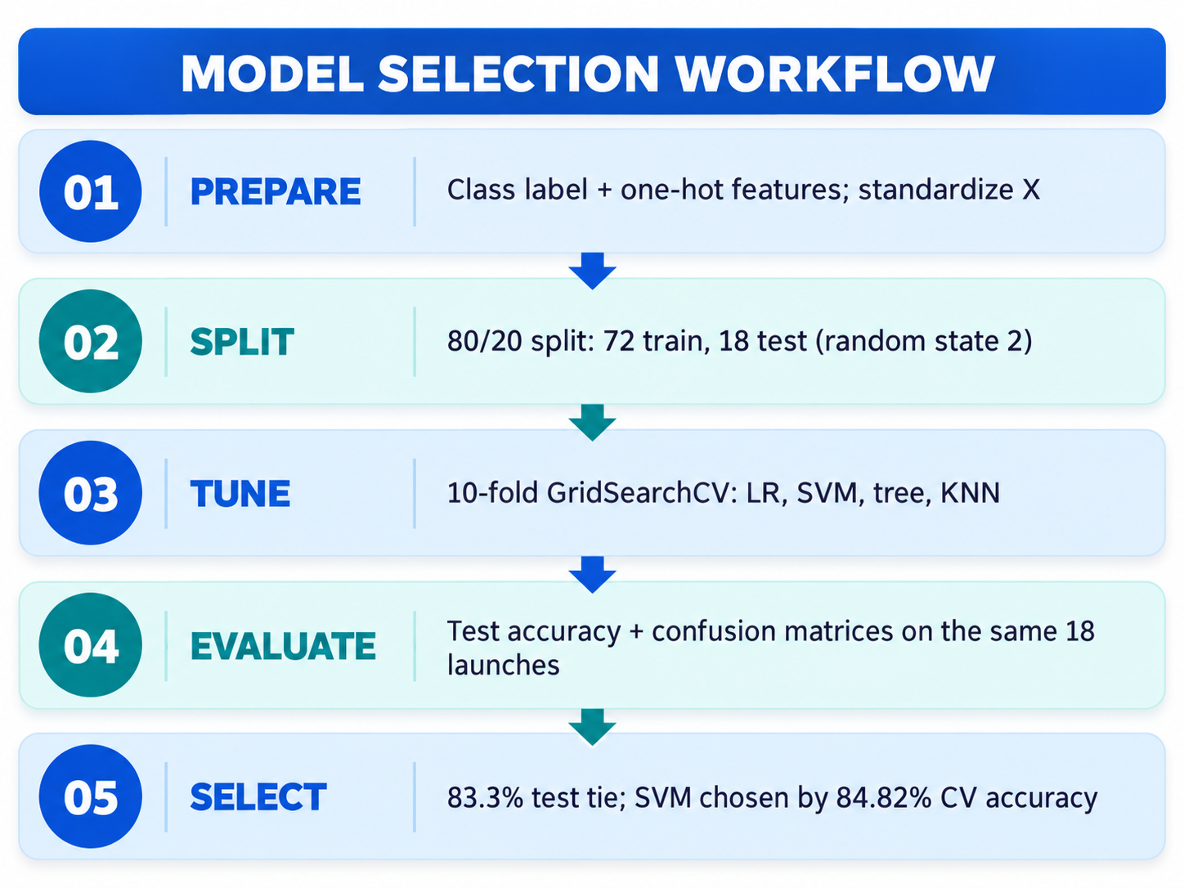
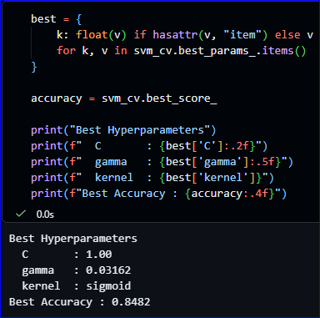
Predictive Analysis (Classification)
TASK 6 | SVM GRID SEARCH
84.82% mean cross-validation accuracy
https://github.com/treinart/IBM-Data-Science-Professional-Certificate/blob/main/10_Applied%20Data%20Science%20Capstone/Module%204/SpaceX-Machine-Learning-Prediction-Part-5-v1.ipynb

Slide 16

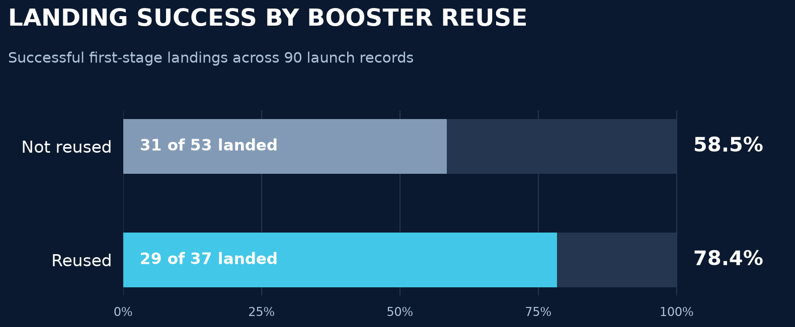
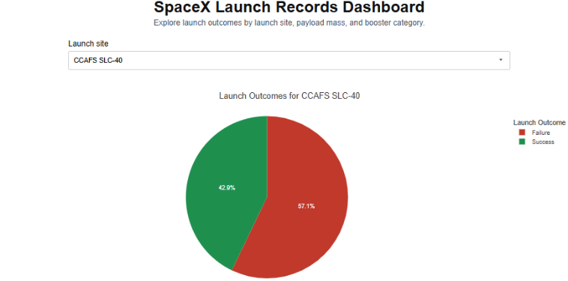
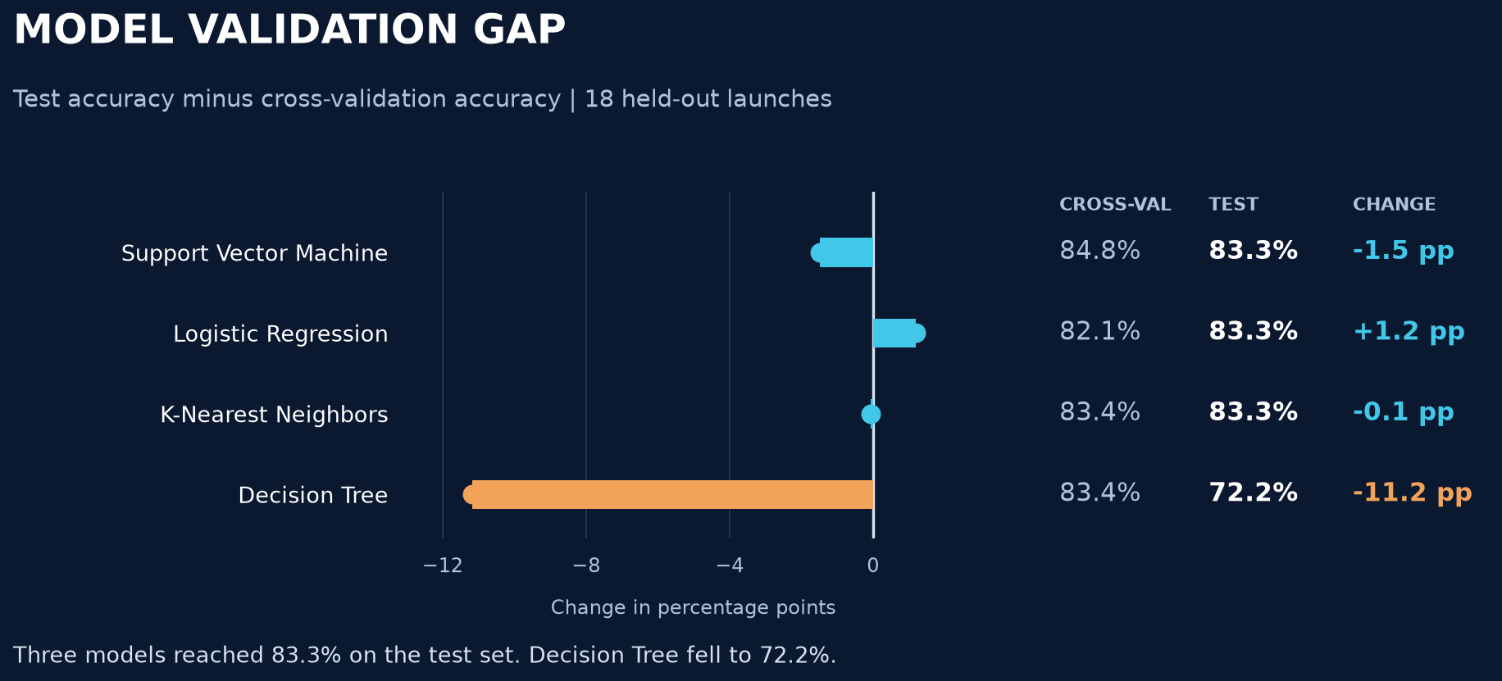
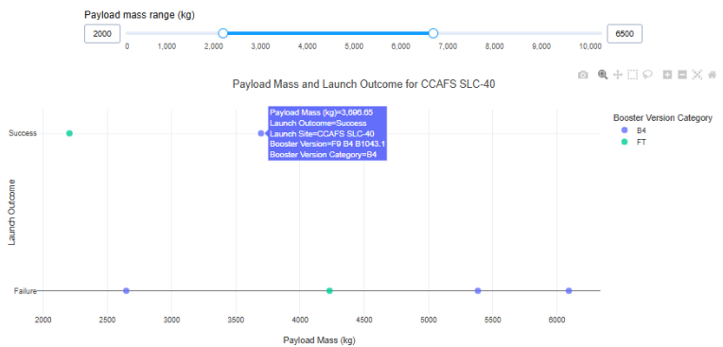
Results
EXPLORATORY ANALYSIS | BOOSTER REUSE
INTERACTIVE DASHBOARD | CCAFS SLC-40
29/37 reused landed (78.4%); 31/53 not reused (58.5%).
3 of 7 launches had successful landings.
PREDICTIVE ANALYSIS | MODEL VALIDATION
INTERACTIVE DASHBOARD | PAYLOAD & SUCCESS
3 models tied at 83.3% test; Decision Tree: 83.4% CV → 72.2% test.
2,000–6,500 kg filter; hover identifies a launch.
EDA notebook
Dash Python
Live dashboard
ML notebook
16

Slide 17
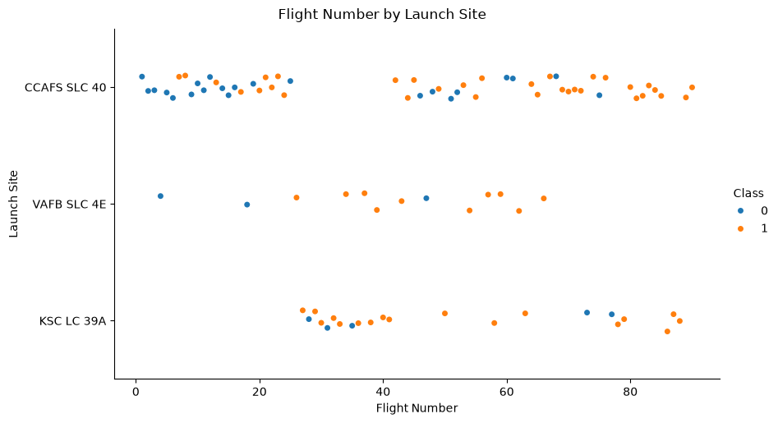
Results | EDA and SQL
SQL NOTEBOOK MILESTONE
December 22, 2015
First successful ground-pad landing
EXPLORATORY DATA ANALYSIS
MISSION OUTCOMES (101-ROW SAMPLE)
99
Success
Primary mission objective achieved
1
Failure (in flight)
Loss during ascent phase
1
Success (payload status unclear)
Orbit reached, payload unverified
17
https://github.com/treinart/IBM-Data-Science-Professional-Certificate/blob/main/10_Applied%20Data%20Science%20Capstone/Module%202/jupyter-labs-eda-dataviz-v2.ipynb
https://github.com/treinart/IBM-Data-Science-Professional-Certificate/blob/main/10_Applied%20Data%20Science%20Capstone/Module%202/jupyter-labs-eda-sql-coursera_sqllite.ipynb

Slide 18
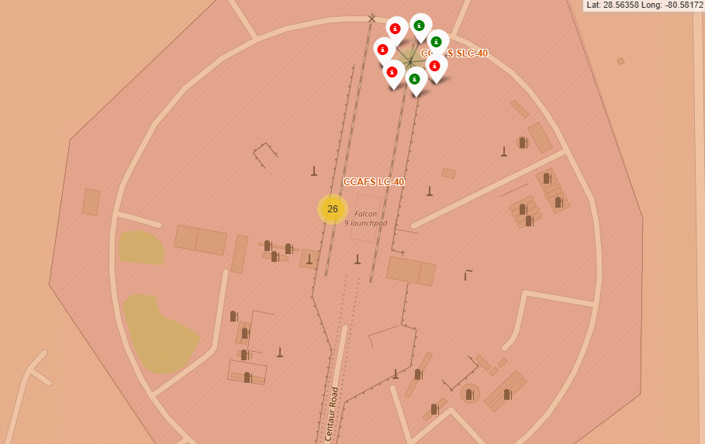
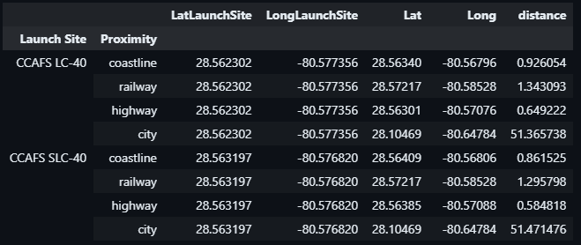
Results | Folium Map
LANDING OUTCOMES AT CCAFS LC-40
NEARBY FEATURES (KM)
The selected coast and highway points are less than 1 km from both CCAFS sites.
Green: landing success Red: landing failure
18
https://github.com/treinart/IBM-Data-Science-Professional-Certificate/blob/main/10_Applied%20Data%20Science%20Capstone/Module%203/lab-jupyter-launch-site-location-v2.ipynb

Slide 19
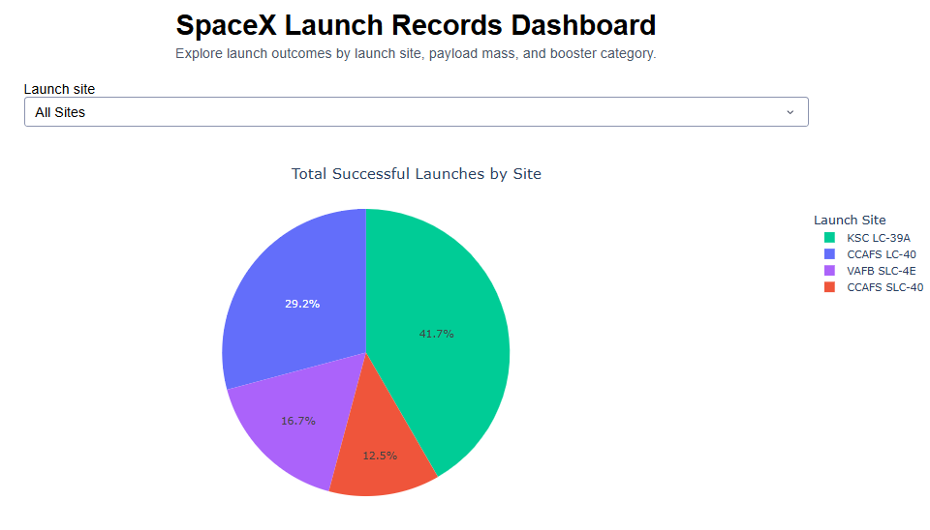
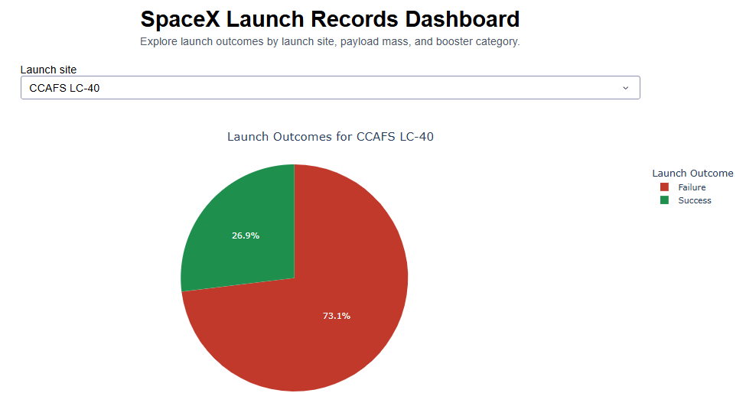
Results | Interactive Analytics
Changing the site filter changes the landing outcome view.
ALL SITES
CCAFS LC-40
41.7%
KSC LC-39A accounts for 41.7% of successful landings.
26.9%
At CCAFS LC-40, 26.9% of launches landed successfully.
https://spacex-launch-analytics.netlify.app/
01-all-sites-dashboard.png
02-selected-site-dashboard.png
19

Slide 20
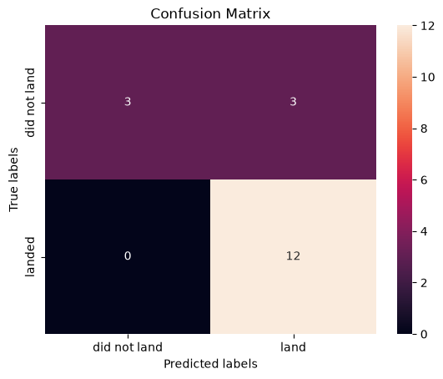
Results | Predictive Models
Three models reached 83.3% test accuracy.
MODEL
ACCURACY
Logistic Regression
83.3%
Support Vector Machine
83.3%
K-Nearest Neighbors
83.3%
Decision Tree
72.2%
The selected SVM found all 12 successes, but missed 3 of 6 failures.
20
https://github.com/treinart/IBM-Data-Science-Professional-Certificate/blob/main/10_Applied%20Data%20Science%20Capstone/Module%204/SpaceX-Machine-Learning-Prediction-Part-5-v1.ipynb

Slide 21

Section 2

Slide 22

Flight Number vs. Launch Site
LATER FLIGHTS
Successful landings appear more often as flight number rises.
Orange (Class 1) marks a successful landing.
https://github.com/treinart/IBM-Data-Science-Professional-Certificate/blob/main/10_Applied%20Data%20Science%20Capstone/Module%202/jupyter-labs-eda-dataviz-v2.ipynb

Slide 23
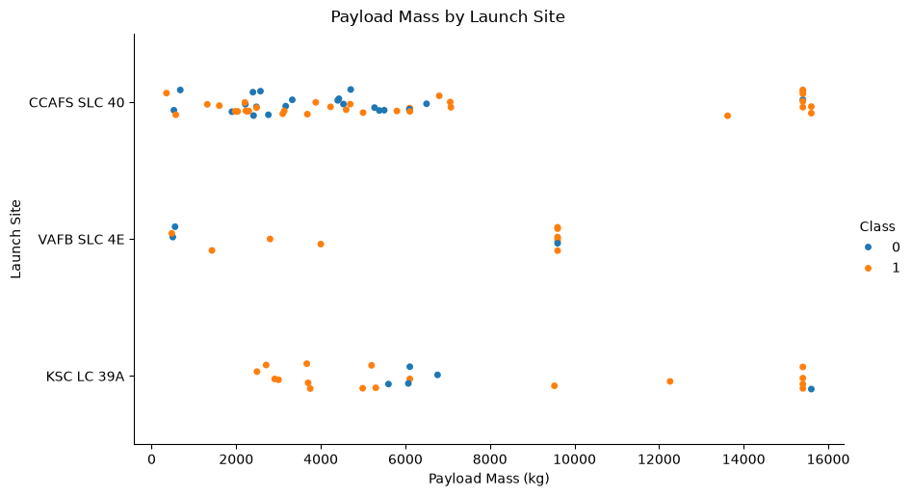
Payload Mass vs. Launch Site
9,600 KG
The heaviest VAFB payload in this sample is 9,600 kg.
Payload mass alone does not separate landing outcomes.
https://github.com/treinart/IBM-Data-Science-Professional-Certificate/blob/main/10_Applied%20Data%20Science%20Capstone/Module%202/jupyter-labs-eda-dataviz-v2.ipynb

Slide 24
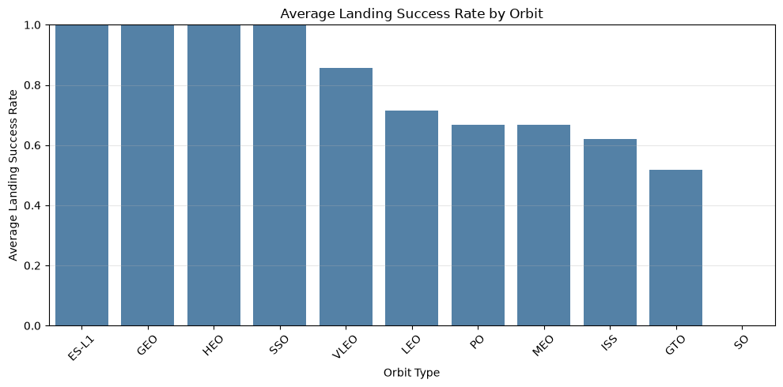
Landing Success Rate by Orbit
86% VS. 52%
VLEO: 12 of 14 landed.
GTO: 14 of 27 landed.
Three 100% orbit bars each represent one flight.
https://github.com/treinart/IBM-Data-Science-Professional-Certificate/blob/main/10_Applied%20Data%20Science%20Capstone/Module%202/jupyter-labs-eda-dataviz-v2.ipynb

Slide 25
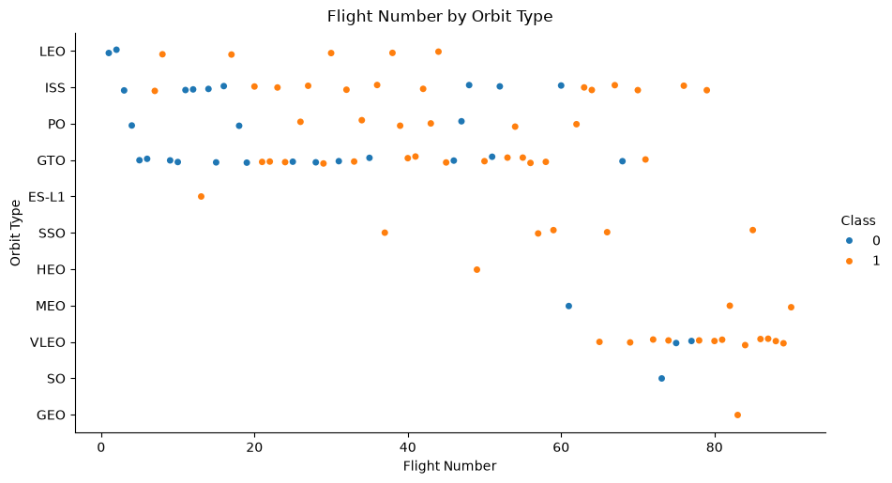
Flight Number vs. Orbit Type
LEO / GTO
Later LEO flights tend to succeed. GTO stays mixed across flight numbers.
Orange (Class 1) marks a successful landing.
https://github.com/treinart/IBM-Data-Science-Professional-Certificate/blob/main/10_Applied%20Data%20Science%20Capstone/Module%202/jupyter-labs-eda-dataviz-v2.ipynb

Slide 26
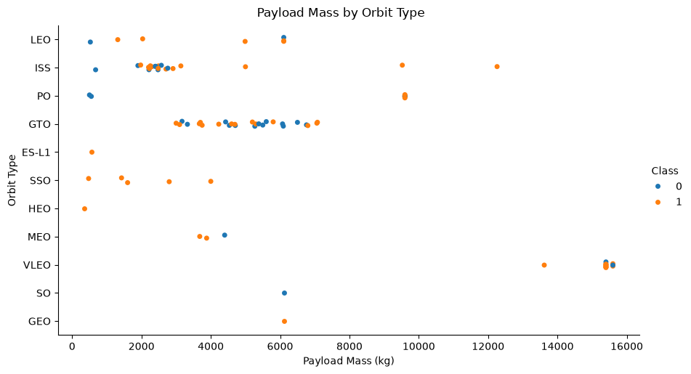
Payload Mass vs. Orbit Type
GTO
Both landing outcomes appear across its payload range.
Payload mass does not show a clear success cutoff.
https://github.com/treinart/IBM-Data-Science-Professional-Certificate/blob/main/10_Applied%20Data%20Science%20Capstone/Module%202/jupyter-labs-eda-dataviz-v2.ipynb

Slide 27
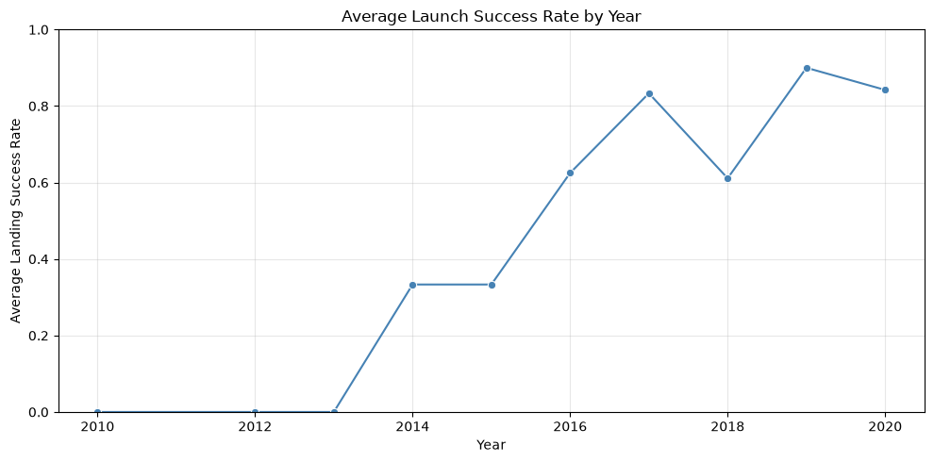
Landing Success Rate by Year
90% IN 2019
After the 2018 dip, landing success passed 80% in both 2019 and 2020.
2019: 9 of 10
2020: 16 of 19
https://github.com/treinart/IBM-Data-Science-Professional-Certificate/blob/main/10_Applied%20Data%20Science%20Capstone/Module%202/jupyter-labs-eda-dataviz-v2.ipynb

Slide 28
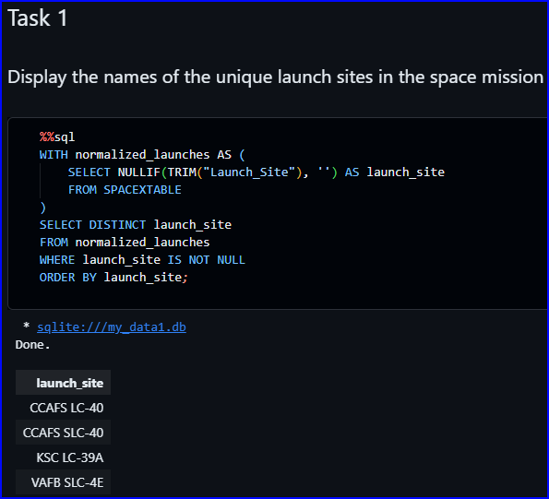
All Launch Site Names
SQL QUERY RESULT
CCAFS LC-40
01
CCAFS SLC-40
02
KSC LC-39A
03
VAFB SLC-4E
04
https://github.com/treinart/IBM-Data-Science-Professional-Certificate/blob/main/10_Applied%20Data%20Science%20Capstone/Module%202/jupyter-labs-eda-sql-coursera_sqllite.ipynb

Slide 29
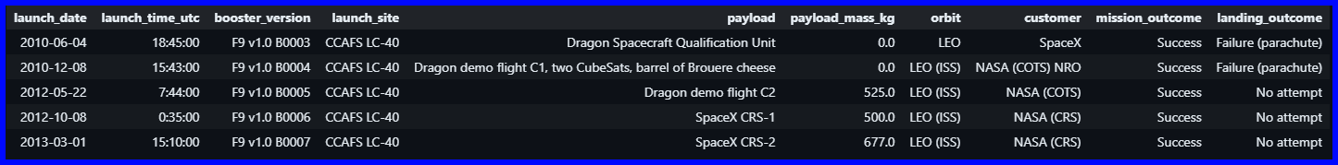
Five Launch Records at CCAFS
5 records where launch_site begins with CCA
06-04-2010
F9 v1.0 B0003
CCAFS LC-40
Failure (parachute)
rocket_launch
5
Early CCAFS Missions
All five missions succeeded. None recorded a successful landing.
12-08-2010
F9 v1.0 B0004
CCAFS LC-40
Failure (parachute)
05-22-2012
F9 v1.0 B0005
CCAFS LC-40
No attempt
10-08-2012
F9 v1.0 B0006
CCAFS LC-40
No attempt
03-01-2013
F9 v1.0 B0007
CCAFS LC-40
No attempt
Task 2 SQL output
https://github.com/treinart/IBM-Data-Science-Professional-Certificate/blob/main/10_Applied%20Data%20Science%20Capstone/Module%202/jupyter-labs-eda-sql-coursera_sqllite.ipynb

Slide 30
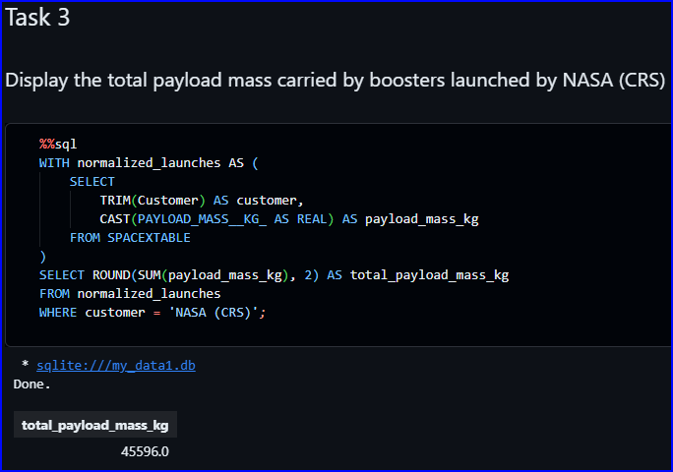
Total Payload Mass for NASA (CRS)
TOTAL PAYLOAD MASS
45,596 kg
NASA (CRS) missions carried this total payload mass in the SQL result.
https://github.com/treinart/IBM-Data-Science-Professional-Certificate/blob/main/10_Applied%20Data%20Science%20Capstone/Module%202/jupyter-labs-eda-sql-coursera_sqllite.ipynb

Slide 31
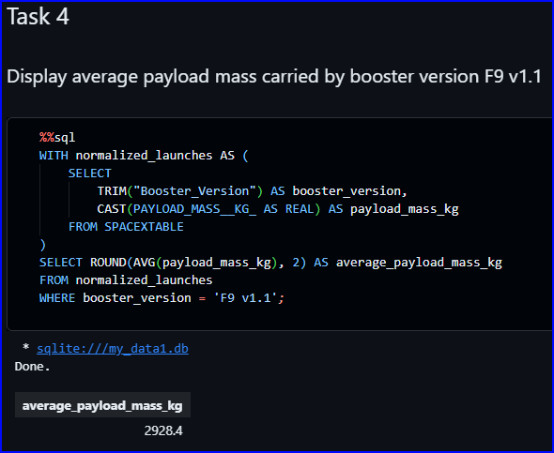
Average Payload Mass for F9 v1.1
AVERAGE PAYLOAD MASS
2,928.4 kg
F9 v1.1 launches carried this average payload mass in the SQL result.
https://github.com/treinart/IBM-Data-Science-Professional-Certificate/blob/main/10_Applied%20Data%20Science%20Capstone/Module%202/jupyter-labs-eda-sql-coursera_sqllite.ipynb

Slide 32
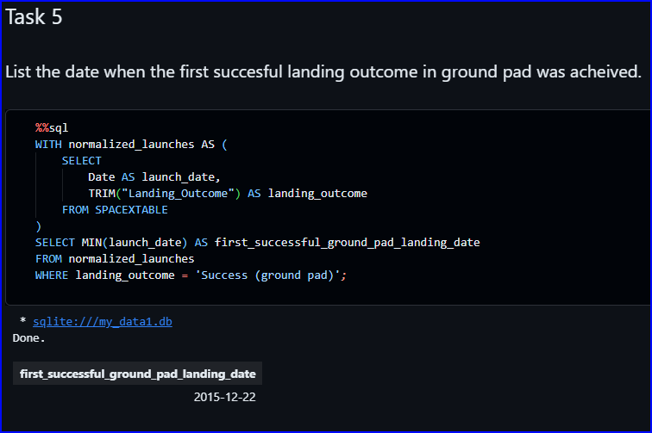
First Successful Ground-Pad Landing
FIRST SUCCESSFUL GROUND-PAD LANDING
December 22, 2015
This is the earliest launch date with a successful ground-pad landing outcome.
https://github.com/treinart/IBM-Data-Science-Professional-Certificate/blob/main/10_Applied%20Data%20Science%20Capstone/Module%202/jupyter-labs-eda-sql-coursera_sqllite.ipynb

Slide 33
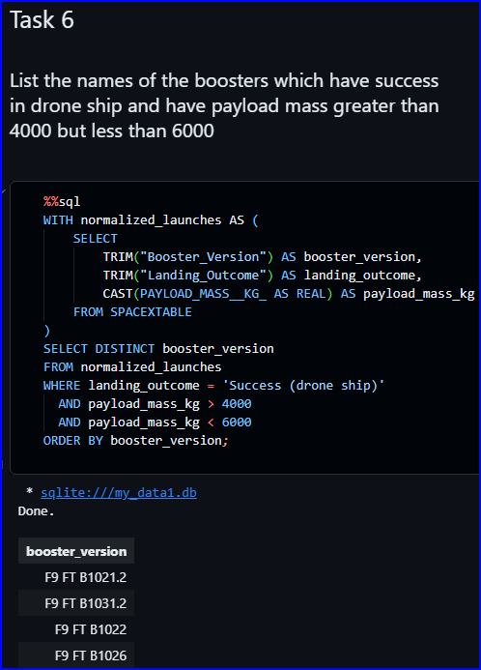
SUCCESSFUL DRONE-SHIP LANDINGS
Drone-Ship Landings: 4,000–6,000 kg
01
F9 FT B1021.2
Falcon 9 Full Thrust • Drone Ship Landing
02
F9 FT B1031.2
Falcon 9 Full Thrust • Drone Ship Landing
03
F9 FT B1022
Falcon 9 Full Thrust • Drone Ship Landing
04
F9 FT B1026
Falcon 9 Full Thrust • Drone Ship Landing
https://github.com/treinart/IBM-Data-Science-Professional-Certificate/blob/main/10_Applied%20Data%20Science%20Capstone/Module%202/jupyter-labs-eda-sql-coursera_sqllite.ipynb

Slide 34
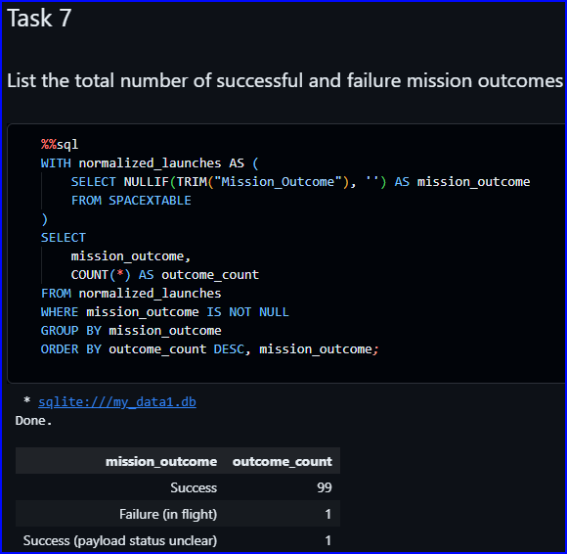
Mission Outcomes in the SQL Dataset
MISSION OUTCOME
COUNT
Success
99
Failure (in flight)
1
Success (payload status unclear)
1
The SQL result counts mission outcomes across 101 launch records.
https://github.com/treinart/IBM-Data-Science-Professional-Certificate/blob/main/10_Applied%20Data%20Science%20Capstone/Module%202/jupyter-labs-eda-sql-coursera_sqllite.ipynb

Slide 35
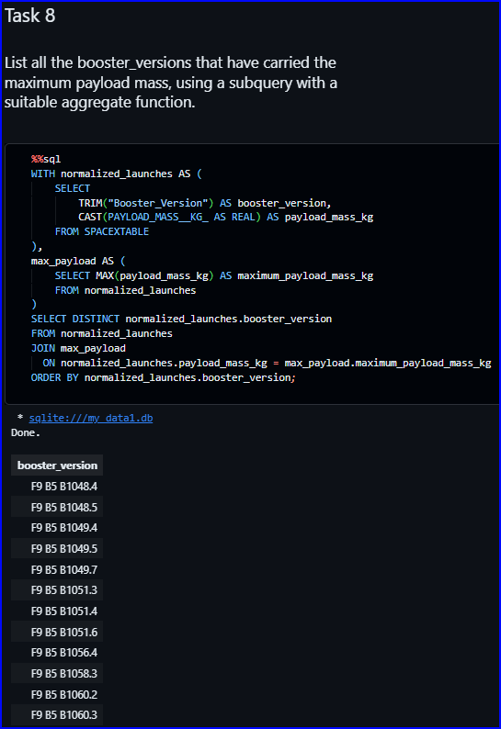
Boosters with the Maximum Payload
12 BOOSTER-VERSION ENTRIES IN THE SQL RESULT
01
F9 B5 B1048.4
07
F9 B5 B1051.4
02
F9 B5 B1048.5
08
F9 B5 B1051.6
03
F9 B5 B1049.4
09
F9 B5 B1056.4
04
F9 B5 B1049.5
10
F9 B5 B1058.3
05
F9 B5 B1049.7
11
F9 B5 B1060.2
06
F9 B5 B1051.3
12
F9 B5 B1060.3
All 12 results are F9 B5 booster-version entries.
https://github.com/treinart/IBM-Data-Science-Professional-Certificate/blob/main/10_Applied%20Data%20Science%20Capstone/Module%202/jupyter-labs-eda-sql-coursera_sqllite.ipynb

Slide 36
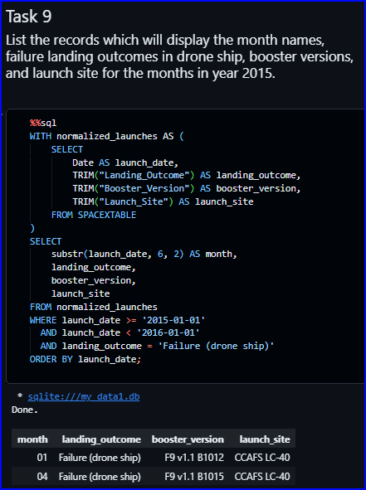
Failed Drone-Ship Landings in 2015
TWO MATCHING SQL RECORDS
JANUARY 2015
APRIL 2015
F9 v1.1 B1012
F9 v1.1 B1015
CCAFS LC-40
CCAFS LC-40
Failure (drone ship)
Failure (drone ship)
Both 2015 drone-ship failures in the result launched from CCAFS LC-40.
https://github.com/treinart/IBM-Data-Science-Professional-Certificate/blob/main/10_Applied%20Data%20Science%20Capstone/Module%202/jupyter-labs-eda-sql-coursera_sqllite.ipynb

Slide 37
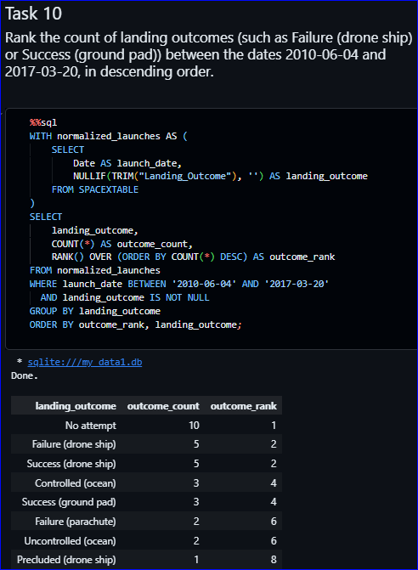
Landing Outcomes Ranked by Count
No attempt is the most common landing outcome, with 10 records.
2010-06-04 TO 2017-03-20
LANDING OUTCOME
COUNT
RANK
No attempt
10
1
Failure (drone ship)
5
2
Success (drone ship)
5
2
Controlled (ocean)
3
4
Success (ground pad)
3
4
Failure (parachute)
2
6
Uncontrolled (ocean)
2
6
Precluded (drone ship)
1
8
https://github.com/treinart/IBM-Data-Science-Professional-Certificate/blob/main/10_Applied%20Data%20Science%20Capstone/Module%202/jupyter-labs-eda-sql-coursera_sqllite.ipynb

Slide 38

Section 3

Slide 39
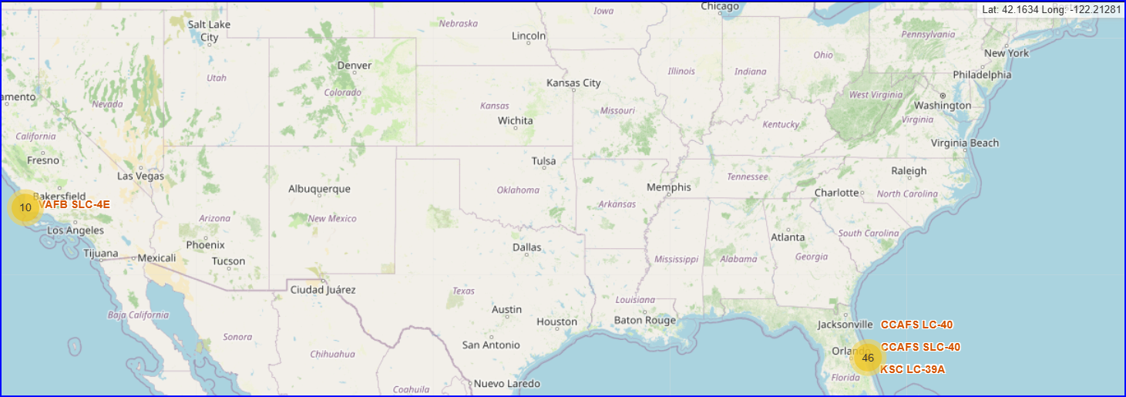
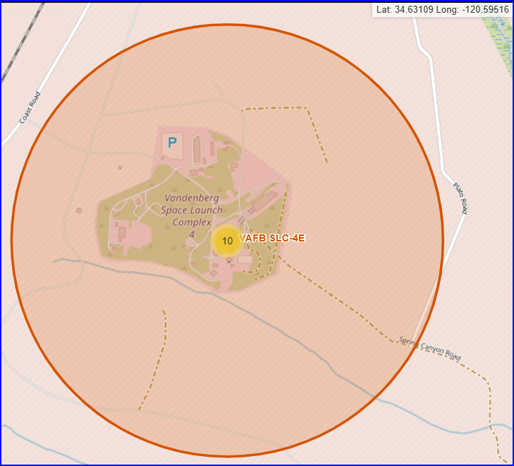
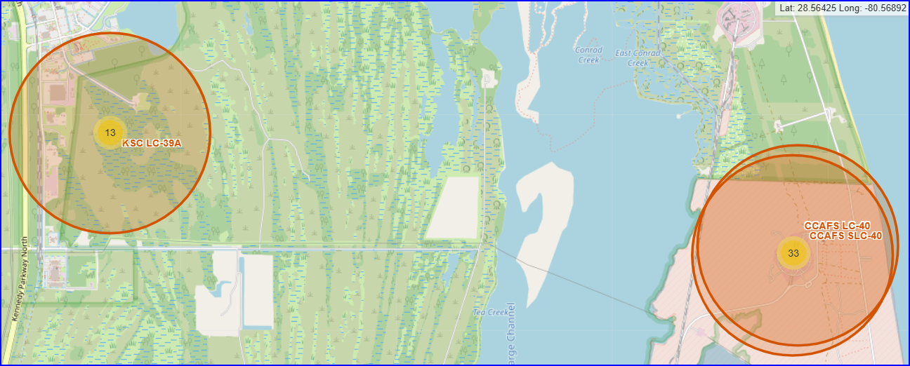
Launch Sites and Record Clusters
LOCATIONS
VAFB SLC-4E is in California; KSC LC-39A and the two CCAFS pads are in Florida.
LAUNCH RECORDS
Yellow circles group launch records: 10 at VAFB and 46 in Florida. The Florida close-up splits those 46 into 13 at KSC and 33 at the two CCAFS pads.
MAP KEY
Orange rings show a 1 km radius around each site. The upper-right coordinates show the cursor position when each map was captured.
https://github.com/treinart/IBM-Data-Science-Professional-Certificate/blob/main/10_Applied%20Data%20Science%20Capstone/Module%203/lab-jupyter-launch-site-location-v2.ipynb

Slide 40
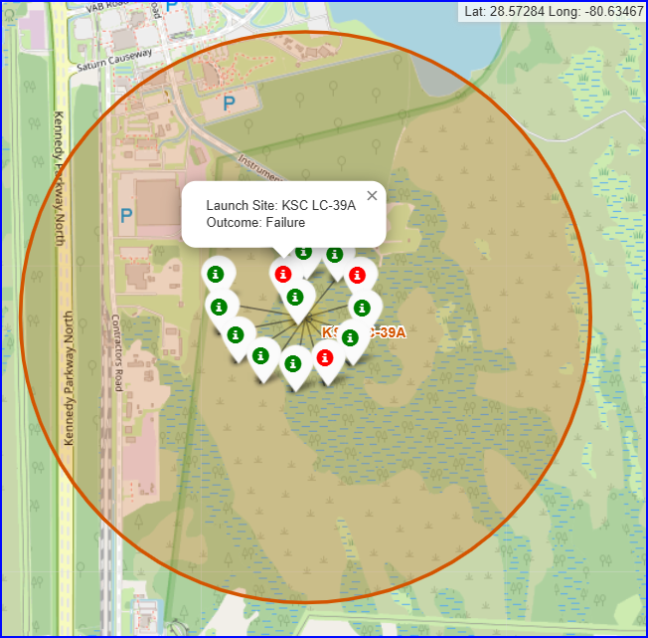
Landing Outcomes at KSC LC-39A
LAUNCH SITE METRICS
KSC LC-39A Launch Complex
13 mapped launch records analyzed in this dataset
10
Successful Landings
76.9% site success rate
3
Failed Landings
23.1% landing failure rate
READING THE MAP
Each marker pin represents an individual launch event. Green indicates a successful first-stage landing, while red denotes a landing failure. The expanded popup details a recorded failure.
GEOGRAPHIC DETAILS
The orange boundary ring illustrates a 1 km proximity perimeter around the launch complex. Upper-right coordinates mark the active cursor position in this capture.
https://github.com/treinart/IBM-Data-Science-Professional-Certificate/blob/main/10_Applied%20Data%20Science%20Capstone/Module%203/lab-jupyter-launch-site-location-v2.ipynb

Slide 41
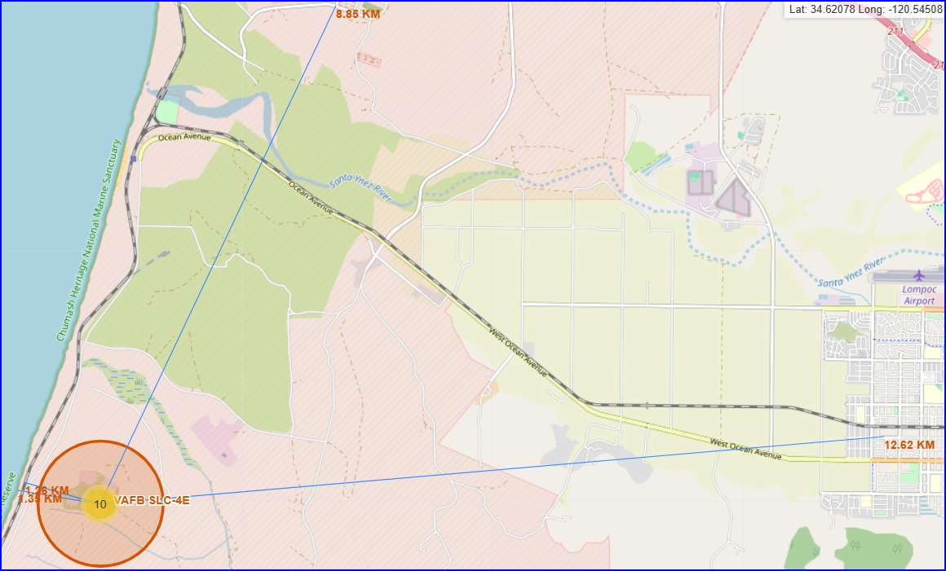
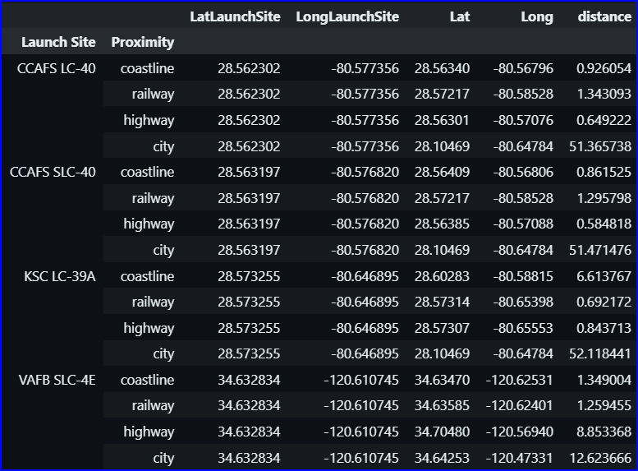
VAFB SLC-4E: Proximity to Key Features
VAFB SLC-4E | SELECTED MAP POINTS
Railway 1.26 km • Coastline 1.35 km
Highway 8.85 km • City 12.62 km
Blue lines connect VAFB to selected feature points. The VAFB rows show the calculated distances. The upper-right coordinates show the cursor position.
Of these selected points, the railway and coast are closest.
https://github.com/treinart/IBM-Data-Science-Professional-Certificate/blob/main/10_Applied%20Data%20Science%20Capstone/Module%203/lab-jupyter-launch-site-location-v2.ipynb

Slide 42

Section 4

Slide 43
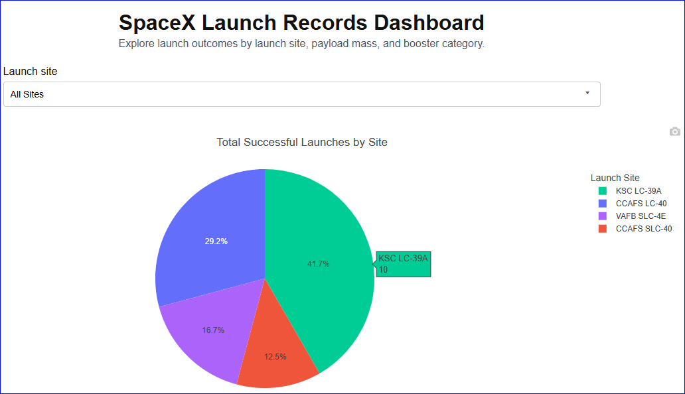
SpaceX Launch Analytics • Dashboard Insights
Successful Landings by Launch Site
ALL-SITE VIEW
Total Success Distribution
Across four active launch sites
41.7%
KSC LC-39A Share
Contributed 10 of 24 successful landings
TOTAL SUCCESSES
24 Landings
Across all 4 sites
KSC LC-39A (10), VAFB SLC-4E (4), CCAFS LC-40 (7), CCAFS SLC-40 (3).
Key Takeaway: Pie slices show landing success share across sites, not individual site launch success rates.
Live app: https://spacex-launch-analytics.netlify.app/
https://github.com/treinart/IBM-Data-Science-Professional-Certificate/blob/main/10_Applied%20Data%20Science%20Capstone/Module%203/spacex-dash-app.py

Slide 44
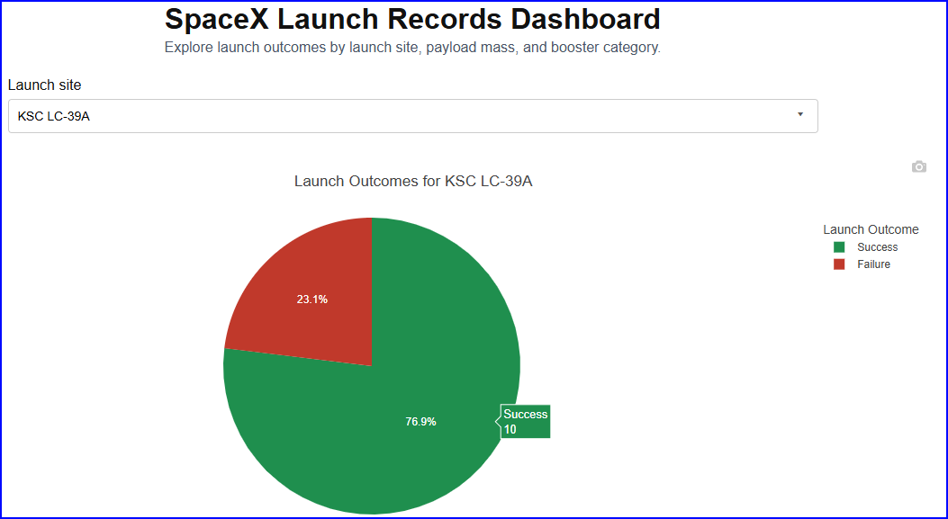
SpaceX Launch Analytics • Dashboard Insights
KSC LC-39A: 76.9% Success Rate
KSC LC-39A
Site Success Breakdown
Highest success rate in this dataset
76.9%
10 / 13 Successful Landings
Only 3 landing failures out of 13 total attempts
OUTCOME SUMMARY
3 Failures
23.1% failure rate
KSC LC-39A demonstrates the highest reliability among all four SpaceX launch facilities.
Interactive Feature: Selecting KSC LC-39A in the dropdown changes the pie chart from all-site share to KSC's specific launch outcomes.
Live app: https://spacex-launch-analytics.netlify.app/
https://github.com/treinart/IBM-Data-Science-Professional-Certificate/blob/main/10_Applied%20Data%20Science%20Capstone/Module%203/spacex-dash-app.py

Slide 45
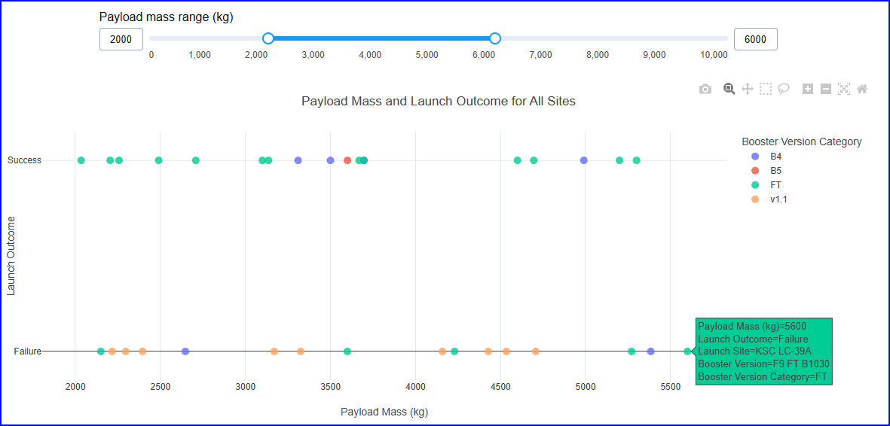
SpaceX Launch Analytics • Dashboard Insights
Payload Mass vs. Landing Outcome
PAYLOAD FILTER
2,000 – 6,000 kg
Applied across all launch sites
18 / 34
Landings Succeeded
52.9% success rate in this range
FT BOOSTER HIGHLIGHT
13 of 18
Successes in FT category
FT boosters achieve a 72.2% success rate in this specific payload bracket.
Key Observation: Each dot represents one launch. Color marks booster category; the hover state details specific failures (e.g., 5,600 kg KSC FT failure).
Live app: https://spacex-launch-analytics.netlify.app/
https://github.com/treinart/IBM-Data-Science-Professional-Certificate/blob/main/10_Applied%20Data%20Science%20Capstone/Module%203/spacex-dash-app.py

Slide 46

Section 5

Slide 47
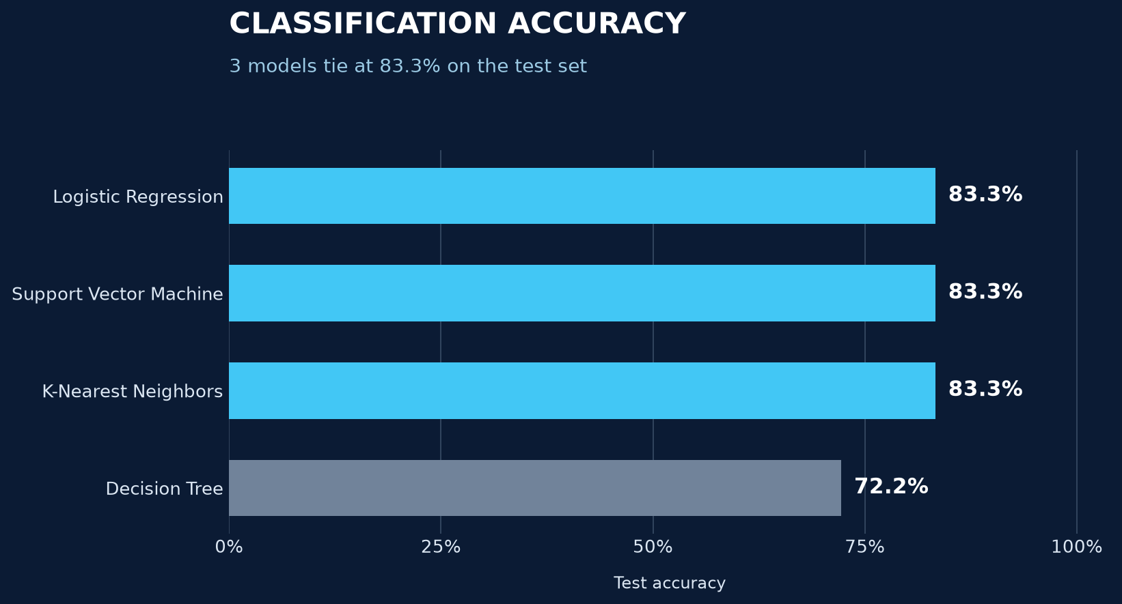
Classification Accuracy
TEST SET
83.3%
Three models tie across 18 launches.
72.2%
Decision tree
SVM selected by 84.8% cross-validation accuracy.
https://github.com/treinart/IBM-Data-Science-Professional-Certificate/blob/main/10_Applied%20Data%20Science%20Capstone/Module%204/SpaceX-Machine-Learning-Prediction-Part-5-v1.ipynb

Slide 48
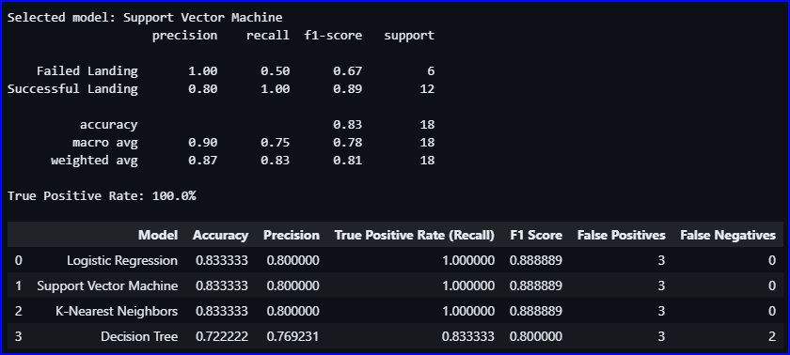
Confusion Matrix
SVM MODEL | 18 TEST LAUNCHES
15 / 18 correct
All 12 successful landings identified; three failures predicted to land.
https://github.com/treinart/IBM-Data-Science-Professional-Certificate/blob/main/10_Applied%20Data%20Science%20Capstone/Module%204/SpaceX-Machine-Learning-Prediction-Part-5-v1.ipynb

Slide 49
Conclusions
Point 1
Point 2
Point 3
Point 4
…

Slide 50
Appendix
Include any relevant assets like Python code snippets, SQL queries, charts, Notebook outputs, or data sets that you may have created during this project

Slide 51


